Slide 1
Object Oriented Programming in Java Lecture 2

Slide 2
Outline
Principles of Object Oriented Programming
Object Oriented Requirements
Object Oriented in Java
Working with Classes and Objects
Using Existing Classes
Constructing New Classes
Super-classes and Sub-classes
Interfaces and Multiple Inheritance

Slide 3
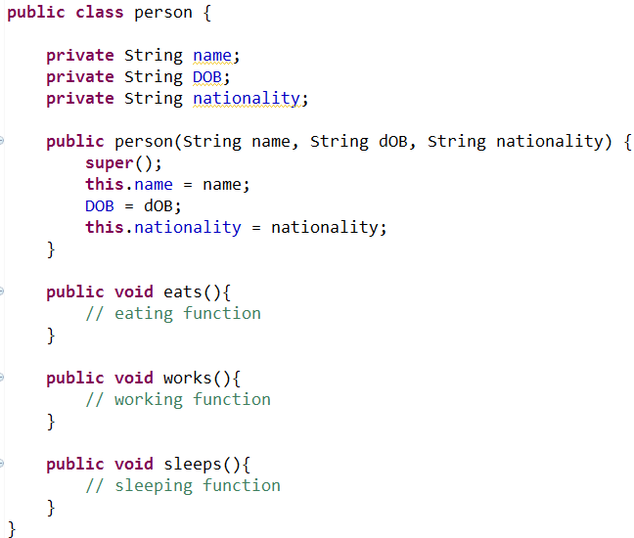
OOP Principles
Java is totally object-oriented programming Language. To understand Java, one must comprehend the basic principles of OOP.
Objects - are basic runtime entity in an object oriented system. It is a real world entity with a bundle of related state and behavior. Object is an instance of Class, We can access Class Member using its Object.
e.g. person
name, DOB, …
eats, works, sleeps, …
Fields
methods

Slide 4
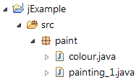
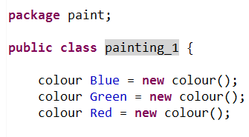
OOP Principles
Class - A prototype from which objects are created. In fact, objects are variables of the type class e.g. objects Blue, Green and Red belongs to Class Colour
Colour
Blue
Green
Red

Slide 5
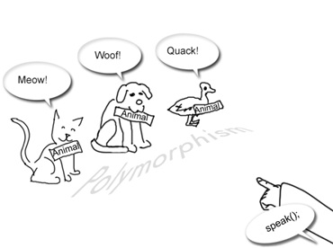
OOP Requirements
What are the OOP Requirements for Classes?
Inheritance:
Inheritance is the process by which objects of one class acquire feature of object of another class
Polymorphism:
the ability to take more than one form
Vehicle
Car
Race Car
class Car extends Vehicle{ …
}
class RaceCar extends Car{ …
}
Animal cat = new Animal(“Meow”)
Animal dog = new Animal(“Woof”)
Animal duck = new Animal(“Quack”)

Slide 6
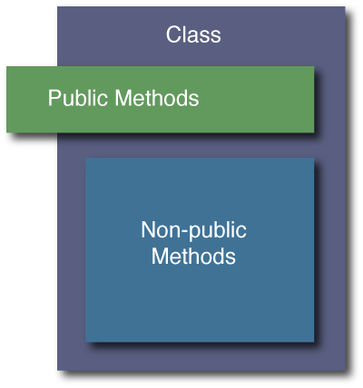
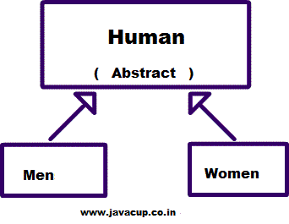
OOP Requirements
Encapsulation: Objects should never directly manipulate the data of another object. All communication should be via messages, i.e. method calls.
Abstraction: Showing essential features
and hiding non-essential features.
public class Car {
private String name;
private int age;
private String manufacturer;
public int getAge() {
return age; }
public String getName(){
return name; }
public String getManufacturer() {
return name; }
public void setAge( int newAge) {
age = newAge; }
public void setName(String newName) {
name = newName; }
}

Slide 7
Working with Classes and Objects
Using Existing Classes
In Java, the keyword new is used to allocate memory space for objects of a certain class, i.e. create an instance of the class.
AudioClip Bell = new AudioClip();
For most Java classes, you create objects, specify their initial state, then work with the objects.
Define object variables
Use the new operator to create the object
Now AudioClip methods can be applied to object bell
AudioClip object
AudioClip
new
AudioClip bell;
bell.play();
AudioClip bell;
bell = new AudioClip();
bell.play();

Slide 8
Working with Classes and Objects
Building new Classes
Classes do not need to be ready to run, stand-alone programs. Most applications comprise many workhorse classes that are the building blocks for constructing stand-alone programs.
class Employee {
private String name;
private double salary;
private int hireyear;
public Employee(String n, double s, int y) {
name = n;
salary = s;
hireyear = y;
}
public void print() {
System.out.println(name + " " + salary + " "
+ hireYear);
}
public void raiseSalary(double byPercent) {
salary *= 1 + byPercent / 100;
}
}
import java.util.*;
public class EmployeeTest
{ public static void main(String[] args)
{
Employee DBeng, WEBdev;
DBeng = new Employee("Harry Hacker",
35000, 2005);
WEBdev = new Employee("Carl Cracker",
25000, 2005);
DBeng.raiseSalary(5);
DBeng.print();
WEBdev.print();
}
}

Slide 9
Working with Classes and Objects
Objects of a class are initialised using constructor methods by giving the instance variables the initial value you want them to have.
The new method is always used with a constructor to create the object.
Constructor methods have the following attributes:
have the same name as the class
may take one or more parameters
always called with the new keyword
have no return value
public Employee (String n, double s, int y) {
name = n;
salary = s;
hireYear = y;
}
Employee netAdmin = new Employee(“Jane Henry”, 24000, 2003);

Slide 10
Working with Classes and Objects
In most classes, data fields are declared private, i.e. they cannot be accessed outside the scope of the class.
Class users work with objects via its methods, therefore these methods are usually declared public. Methods have access to all the class data fields.
If the class user has legitimate interest in setting and modifying private data fields, the class implementers need to supply public field accessor & mutator methods.
private String name;
private double salary;
public void raiseSalary(double byPercent) {
salary *= 1 + byPercent / 100;
}
netAdmin.raiseSalary(5); // raises the salary of netAdmin by 5%
public String getName() {
return name;
}

Slide 11
Working with Classes and Objects
public fields are dangerous, private methods are used frequently. These methods can only be called from within the class.
To implement a private method, the public keyword is changed to private.
Class can have static data fields and methods. Static data fields do not change from one class instance (object) to the other.
static methods belong to the class and do not operate on any instance of the class. Therefore, they can be used without creating an instance of a class.
private String capitalise(String name){
. . . // code to convert Employee name to uppercase
}
netAdmin.capitalise(); // will produce a compiler error
public String getName() {
return capitalise(name); // proper use
}
static int hour = 3600;
Double X = Math.pow(3,0.1);

Slide 12
Working with Classes and Objects
Inheritance - New classes can be derived from existing classes. It allows the reuse of existing classes, as well as adding new instance fields and methods to adapt to new situations.
Create a new class for company managers that have different privileges:
Salary raises are calculated differently
Managers have access to a secretary
Adequate solution: create a new class, Manager, add new functionality to it, but retain the common functionality in the Employee class.
class Manager extends Employee {
public Manager(String n, double s, int y){
super(n, s, y);
secretaryName = "";
}
public void raiseSalary(double byPercent){
//add 1/2% bonus for every year of service
int thisYear = 2005;
double bonus = 0.5*(this year - hireYear);
super.raiseSalary(byPercent + bonus);
}}
public void setSecretaryName(String n){
secretaryName = n;
}
public String getSecretaryName(){
return secretaryName;
}
private String secretaryName;

Slide 13
Working with Classes and Objects
The keyword extends is used to derive a new class from an existing class.
The existing class is called super class, parent class, or base class. The new class is called subclass, derived class or child class.
The Keyword super refers to the superclass
netAdmin = new Employee (“Nadia Ahmed”, 35000, 2003);
CEO = new Manager (“Carl Hendry”, 75000, 1995);
netAdmin.raisSalary(5); // raises the salary by 5%
CEO.raiseSalary(5); // raises the salary by 10% (5 + 0.5*10)
class Manager extends Employee
public Manager(String n, double s, int y) {
super(n, s, y);
secretaryName = “N/A”;}
public void raiseSalary(double byPercent) { // add 0.5% bonus for every year of service
int thisYear = 2005;
double bonus = 0.5*(thisYear - hireYear);
super.raiseSalary(byPercent + bonus);}

Slide 14
Working with Classes and Objects
Interfaces and Multiple Inheritance
Multiple Inheritance: A class inherits from more than one class.
Java doesn’t allow multiple inheritance. It was considered very complex for compilers (as in C++) or inefficient (as in Eifell).
Instead, the concept of interface is introduced.
Super Class
Parent 1
Super Class
Parent 2
Sub Class
Child
class Child extends Parent1, Parent2

Slide 15
Working with Classes and Objects
A class implementing an interface promises to give the code of certain methods with certain signatures. The way in which these methods are implemented is up to the class.
If we want to introduce pension service for example, for every employee in the company, but the type of the pension scheme might vary from a branch to the other we create a pension interface.
The code promises that any class that implements PensionScheme interface will have a calculatePension method that returns a double value (the pension).
public interface PensionScheme {
public double calculatePension();
}

Slide 16
Working with Classes and Objects
A class implements an interface by using the word implements.
The Employee class can implement the pensionScheme interface as follows:
Java allows the implementation of multiple interfaces. The following syntax is valid:
class Employee implements PensionScheme {
public Employee(String n, double s, Day d){ . . .
. . .
public double calculatePension()
{ . . .
. . . // implementation of the method
}
}
class Employee implements PensionScheme, XmasBonus
class Child implements Parent1, Parent2

